Slide 1

CSCE 121 Introduction to Program Design & Concepts
Pointers
Dr. Tim McGuire
Grateful acknowledgment to Dr. Philip Ritchey and Dr. Michael Moore for some of the material on which these slides are based.

Slide 2
Getting the Address of a Variable
Each variable in program is stored at a unique address
Use address operator & to get address of a variable:
int num = 42;
cout << &num; // prints address of num
// in hexadecimal

Slide 3
Pointer Variables
Pointer variable : Often just called a pointer, it's a variable that holds an address
Because a pointer variable holds the address of another piece of data, it "points" to the data

Slide 4
Pointer Variables
Definition:
int *intptr;
Read as:
“intptr can hold the address of an int”
Spacing in definition does not matter:
int * intptr; // same as above
int* intptr; // same as above

Slide 5
Pointer Variables
Assigning an address to a pointer variable:
int *intptr;
intptr = &num;
Memory layout:
num
intptr
42
0x6a00
address of num: 0x6a00

Slide 6
Pointer Variables
Initialize pointer variables with the special value nullptr.
In C++11, the nullptr key word was introduced to represent a pointer that does not point to a valid location (actually, location 0).
Before C++11, a macro named NULL was used for this purpose.
Here is an example of how you define a pointer variable and initialize it with the value nullptr:
int *ptr = nullptr;

Slide 7
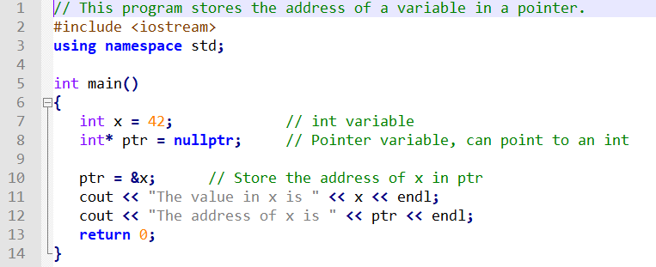
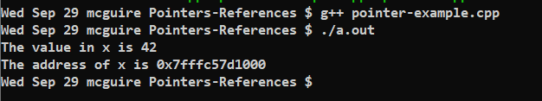
A Pointer Variable in a Program
pointer-example.cpp

Slide 8
The Indirection Operator
The indirection operator (*) dereferences a pointer.
It allows you to access the item to which the pointer points. int* intptr; int x = 42; intptr = &x; cout << *intptr << endl;
This prints 42.

Slide 9
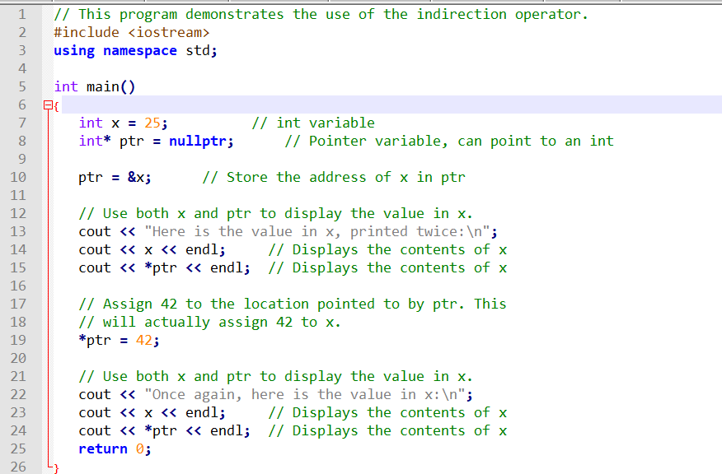
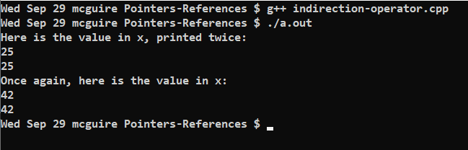
The Indirection Operator in a Program
indirection-operator.cpp

Slide 10
The Relationship Between Arrays and Pointers
Array name is starting address of array
int vals[] = {5, 7, 11};
cout << vals; // displays 0x6a00
cout << vals[0]; // displays 5
5 | 7 | 11
starting address of vals: 0x6a00

Slide 11
The Relationship Between Arrays and Pointers
An array name can be used as a pointer constant:
int vals[] = {4, 7, 11};
cout << *vals; // displays 4
A pointer can be used as an array name:
int *valptr = vals;
cout << valptr[1]; // displays 7

Slide 12
The Array Name Being Dereferenced in a Program
// This program shows an array name being dereferenced with the * operator.
#include <iostream>
using std::cout, std::endl;
int main()
{r
int numbers[] = {10, 20, 30, 40, 50};
cout << "The first element of the array is ";
cout << *numbers << endl;
return 0;
}
Program Output The first element of the array is 10

Slide 13
Pointers in Expressions
Given:
int vals[]={4,7,42}, *valptr;
valptr = vals;
What is valptr + 1? It means (address in valptr) + (1 * size of an int)
cout << *(valptr+1); //displays 7
cout << *(valptr+2); //displays 42
Must use ( ) as shown in the expressions

Slide 14
Array Access
Array elements can be accessed in many ways:
Array access method | Example
array name and [] | vals[2] = 42;
pointer to array and [] | valptr[2] = 42;
array name and subscript arithmetic | *(vals + 2) = 42;
pointer to array and subscript arithmetic | *(valptr + 2) = 42;

Slide 15
Array Access
In other words,
If a is an array, and i is an index into the array, then a[i] and *(a+i) mean exactly the same thing
(As a matter of fact, when the C++ compiler sees an expression like a[i], it converts it to *(a+i) before translating it into machine code.)
No bounds checking performed on array access, whether using array name or a pointer

Slide 16
Pointer Arithmetic

Slide 17
Pointer Arithmetic
Operations on pointer variables:
Operation | Example int vals[]={4,7,11}; int *valptr = vals;
++, -- | valptr++; // points at 7 valptr--; // now points at 4
+, - (pointer and int) | cout << *(valptr + 2); // 11
+=, -= (pointer and int) | valptr = vals; // points at 4 valptr += 2; // points at 11
- (pointer from pointer) | cout << valptr–val; // difference //(number of ints) between valptr // and val

Slide 18
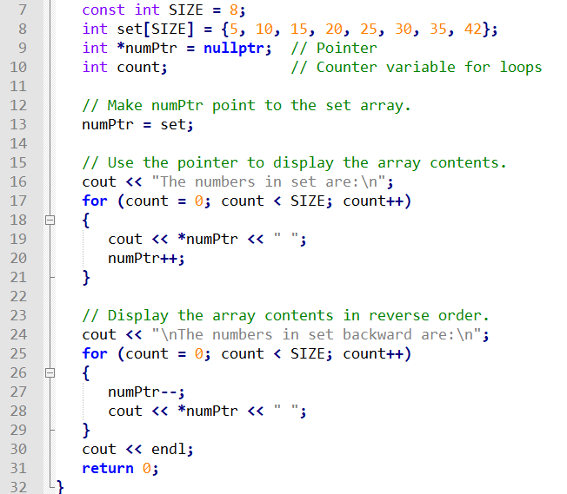
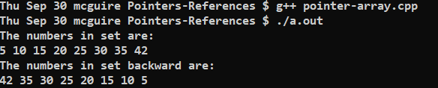
Using a Pointer to Display Array Contents

Slide 19
Initializing Pointers

Slide 20
Initializing Pointers
Can initialize at definition time:
int num, *numptr = &num;
int val[3], *valptr = val;
Cannot mix data types:
double cost;
int *ptr = &cost; // won’t work
Can test for an invalid address for ptr with:
if (!ptr) ...

Slide 21
Comparing Pointers

Slide 22
Comparing Pointers
Relational operators (<, >=, etc.) can be used to compare addresses in pointers
Comparing addresses in pointers is not the same as comparing contents pointed at by pointers:
if (ptr1 == ptr2) // compares addresses
if (*ptr1 == *ptr2) // compares contents

Slide 23
CSCE 121 Introduction to Program Design & Concepts
Passing by Reference
Dr. Tim McGuire
Grateful acknowledgment to Dr. Philip Ritchey and Dr. Michael Moore for some of the material on which these slides are based.

Slide 24
Using Reference Variables as Parameters
A mechanism that allows a function to work with the original argument from the function call, not a copy of the argument
Allows the function to modify values stored in the calling environment
Provides a way for the function to ‘return’ more than one value

Slide 25
Passing by Reference
A reference variable is an alias for another variable
Defined with an ampersand (&)
void getDimensions(int&, int&);
Changes to a reference variable are made to the variable it refers to
Use reference variables to implement passing parameters by reference

Slide 26
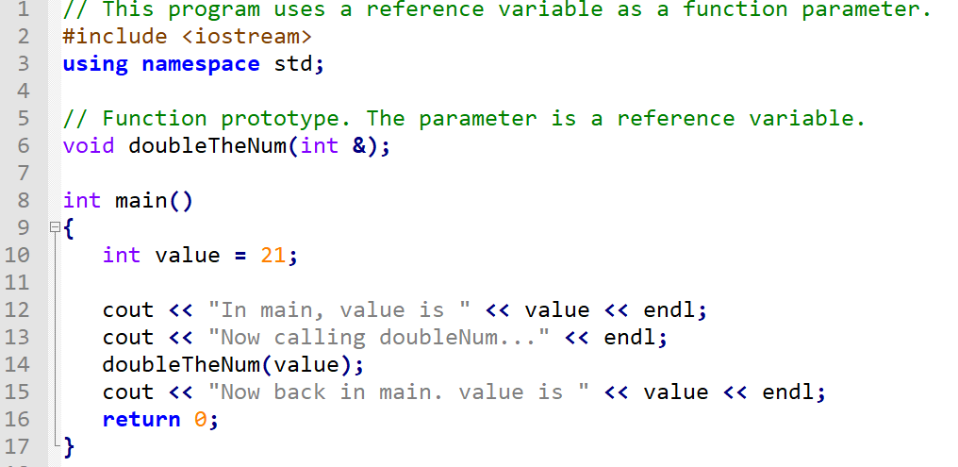
The & in the prototype indicates that the parameter is a reference variable
Here we are passing the variable by reference
(Program Continues)

Slide 27
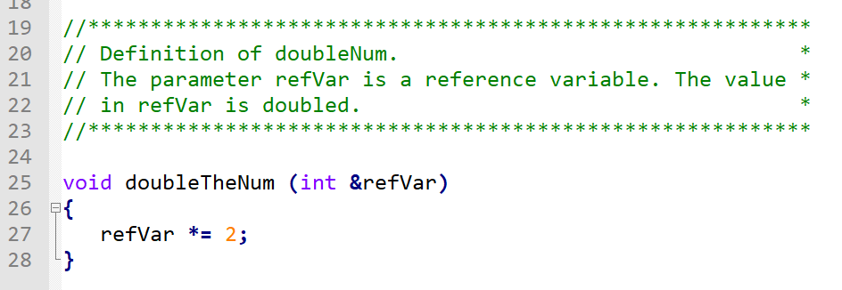
The & also appears in the function header indicating that the parameter is a reference variable

Slide 28
Reference Variable Notes
Each reference parameter must contain &
Space between type and & is unimportant
Must use & in both prototype and header
Argument passed to reference parameter must be a variable – cannot be an expression or constant
Use when appropriate – don’t use when argument should not be changed by function, or if function needs to return only 1 value

Slide 29
Pointers as Function Parameters

Slide 30
Pointers as Function Parameters
A pointer can be a parameter
Works like reference variable to allow change to argument from within function
Requires:
asterisk * on parameter in prototype and heading
void getNum(int *ptr); // ptr is pointer to an int
asterisk * in body to dereference the pointer
cin >> *ptr;
address as argument to the function
getNum(&num); // pass address of num to getNum

Slide 31
Example
void swap(int *x, int *y)
{ int temp;
temp = *x;
*x = *y;
*y = temp;
}
int num1 = 2, num2 = -3;
swap(&num1, &num2);

Slide 32
Pointer vs. Reference
void swap(int *x, int *y)
{ int temp;
temp = *x;
*x = *y;
*y = temp;
}
int num1 = 2, num2 = -3;
swap(&num1, &num2);
void swap(int &x, int &y)
{ int temp;
temp = x;
x = y;
y = temp;
}
int num1 = 2, num2 = -3;
swap(num1, num2);

